Slide 1
Why should one get COVID vaccine?
DRS Than N. Oo & Aye A. Mar. DECEMBER 2021
Burma Center
Battle Creek, Michigan

Slide 2
Why one should get COVID vaccine?
  They are effective
    Primary efficacy
    Even if infection develops – less severe form of illness
  Safe & benefits outweighs minor risks
  Prevent both you and your community/family from infection
  With lifting of mask and social distancing restrictions – unvaccinated ones are doubly at more risk
  Overwhelming data indicates unvaccinated ones get COVID multiple times more than vaccinated ones and likewise die or critically ill multiple times more

Slide 3
Available COVID vaccines in USA & indications
(December 2021)
Pfizer-BioNTech | Moderna | Johnson & Johnson/Janssen
Age recommended 5+ years old | Age recommended 18+ years old | Age recommended 18+ years old
Primary series 2 doses 3 wks. apart | Primary series 2 doses 4 wks. apart | Primary series 1 dose
Booster: 18 and older,6 months after last dose, any vaccine interchangeable | Booster: 18 and older,6 months after last dose, any vaccine interchangeable | Booster: 18 and older,2 months after last dose, any vaccine interchangeable
When is fully vaccinated? 2 wks. after second dose | When is fully vaccinated? 2 wks. after second dose | When is fully vaccinated? 2 wks. after first dose

Slide 4
Safety and efficacy of COVID Vaccines ( Ref: CDC)
Pfizer-BioNTech (mild local reaction & fever just like any vaccine, true allergy rare) | Moderna(mild local reaction & fever just like any vaccine, true allergy rare) | Johnson & Johnson (mild local reaction & fever just like any vaccine, true allergy rare)
16 & older –fully FDA approved Age 5-16 – emergency FDA approval | 18 & older –fully FDA approved | 18 & older –fully FDA approved
91% effective in preventing COVID-19 | 94 % effective in preventing COVID-19 | 85 % effective in preventing COVID-19
Small incidence of mild inflammation of the heart(myocarditis) ~ 50/million incidence – most require no treatment, in 12-17 group | Small incidence of mild inflammation of the heart(myocarditis) ~ 50/million incidence– most require no treatment - in 12-17 group | Small incidence of mild inflammation of the heart(myocarditis) ~ 50/million incidence – most require no treatment -in 12-17 group
 |  | Small incidence of blood clotting in women 18-49 ( ~ 7/million incidence)

Slide 5
Were the COVID vaccines rushed? Was it a new technology?
Only paper work was rushed
Enrollment quota filled up so quickly as many were afflicted from COVID
Principles of this mRNA vaccine technology was already known for a decade
Manufacturing capacity was significantly ramped up through government support of pharmaceutical companies

Slide 6
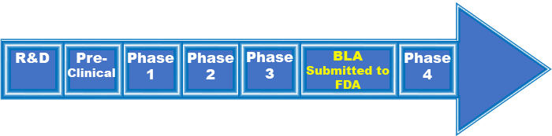
Stages in the development of a vaccine

Slide 7
Status of Vaccination:
USA ( as of 30 Nov 2021)
  At least one dose – 232 millions ( 70.7% of population)
  Fully vaccinated – 195 millions ( 59.3 %)
  Booster – 40 millions ( 12.2%)
Michigan
  One dose – 61.4 %
  Fully – 54.6%
Calhoun County
  One dose – 54.4 %
  Fully – 49%
World – 7.9 billion doses had been administered.

Slide 8
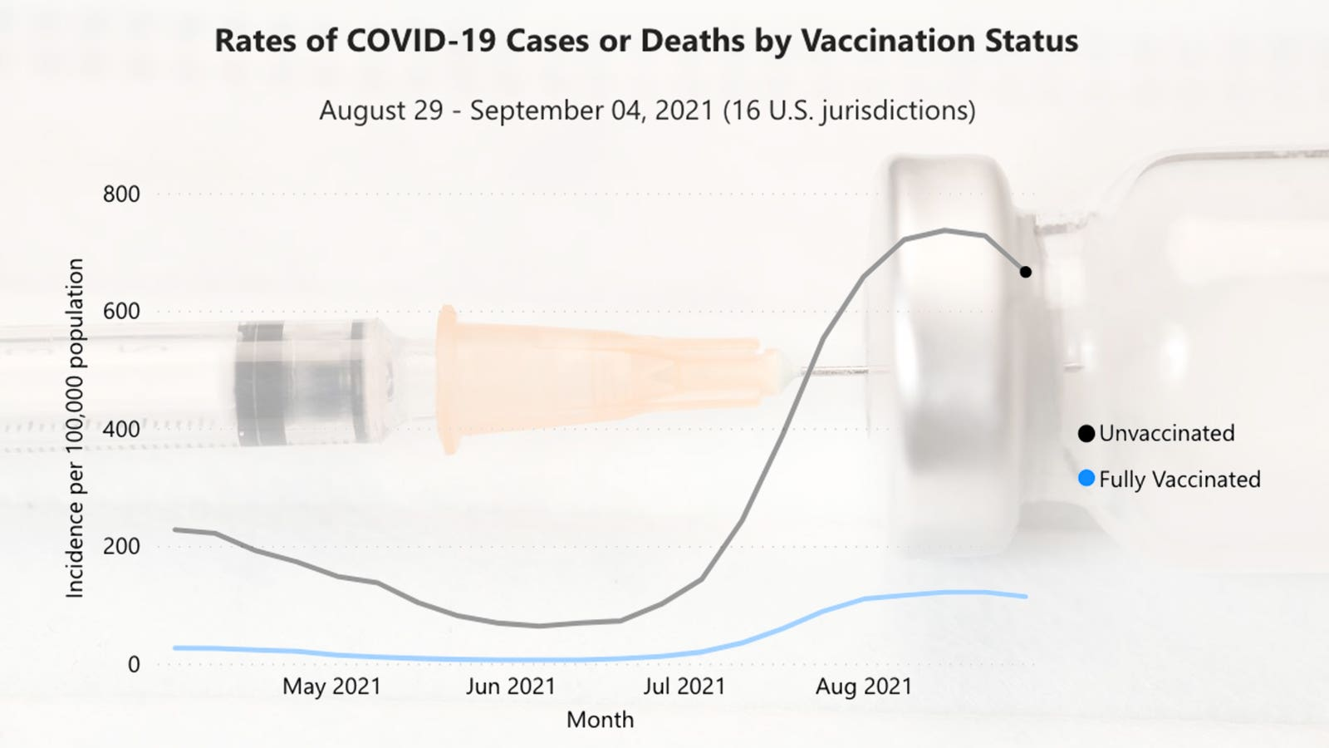

Slide 9
https://covid.cdc.gov/covid-data-tracker/#covidnet-hospitalizations-vaccination
Summary
For all adults aged 18 years and older, the cumulative COVID-19-associated hospitalization rate was about 9 times higher in unvaccinated persons.
Although weekly rates can vary, the cumulative rate of COVID-19-associated hospitalizations in unvaccinated adolescents ages 12-17 years was about 10 times higher than fully vaccinated adolescents aged 12-17 years.
Although weekly rates can vary, the cumulative rate of COVID-19-associated hospitalizations in unvaccinated adults ages 18-49 years was about 14 times higher than fully vaccinated adults aged 18-49 years.
Although weekly rates can vary widely, the cumulative rate of COVID-19-associated hospitalizations in unvaccinated adults ages 50-64 years was about 13 times higher than fully vaccinated adults aged 50-64 years.
Although weekly rates can vary widely, the cumulative rate of COVID-19-associated hospitalizations in unvaccinated adults ages 65 years and older was about 6 times higher than fully vaccinated adults ages 65 years and older.
An unvaccinated person has X14 times higher risk of death from COVID than a vaccinated person

Slide 10
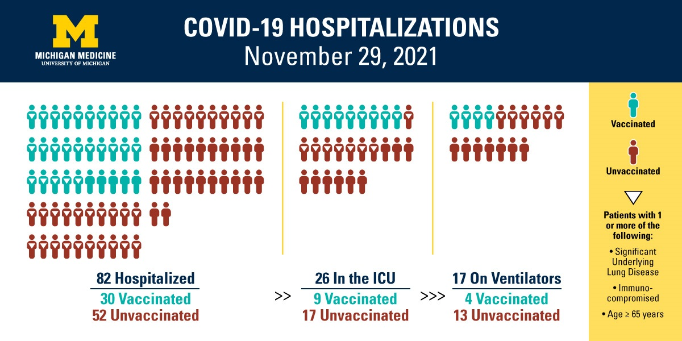
LOCAL DATA

Slide 11
Why should children be vaccinated?
  COVID can still give you severe illness and death in kids (multi system inflammatory syndrome -MIS-C)
  Safe in children
  Unvaccinated children may spread infection at home and school
  Children 5-11 – receives half the dose of adults

Slide 12
Do current vaccines protect the variant strains?
May be slightly less effective but still definitely protective ( e.g. Pfizer 88% vs 91% for the original, Moderna 72% vs 94%)
Breakthrough infection – is when a vaccinated person still getting COVID infection
  Still possible as vaccines were not 100% protective as we know
  But symptoms and severity are very much mild

Slide 13
Should I be vaccinated even after I got COVID?
yes, natural immunity doesn’t last predictably long
  When – if you were treated with monoclonal antibodies/convalescent plasma – wait 90 days otherwise once you have recovered from symptoms of COVID illness and once isolation period/criteria is completed.
  Children who developed MIS-C – wait 90 days

Slide 14
Omicron variant:
  The new COVID-19 variant, called B.1.1.529, has a very unusual constellation of mutations, which are worrying because they could help it evade the body's immune response and make it more transmissible, scientists have said.
  First discovered/identified in S. Africa but suspected to have spread to other parts of world, at least 6-10 European countries confirmed its arrival. Likely in US by now too.
  detected more than 30 mutations to the spike protein. In comparison, the Beta and Delta variant respectively have three and two mutations. The latter originated in India.
  So far more transmissible – unclear as to more severe symptoms or not.
  Current vaccines - should still provide some but reduced efficacy in protection. Drug companies already working on vaccine against newer variants.
  How to prevent – vaccinate, get booster and go back to social distancing and mask wearing habits of earlier parts of Pandemic.

Slide 15
Different techniques/classes in COVID vaccine development
Traditional killed virus or live attenuated vaccine ( e.g. Polio, Measles)
  Sinovac & Sinopharm( China)
Using a subunit of viral protein ( eg Hepatitis B vaccine)
  Novavax ( Maryland, USA)
mRNA technology – making host cells manufacture spike protein
  mRNA in a harmless viral vector
    Oxvord-AstraZanneca, Johnson & Johnson, Russian Sputnik
  Nanotechnology prepared mRNA molecule
    Pfizer-BioNTech, Moderna

